Slide 1

Video Game Data Analysis
Advance Excel Project

Slide 2
Table of Contents
About the Dataset
Important Business Objectives
Overall Ideas about Dashboards
Charts & Business Insights
Thank You

Slide 3
About the Dataset
Total of nine columns
Platform → On which platform the game was created or published
Years → Game realized or published year
Genre → Type or category of the video game
Publisher → Name of the publishers who have published those video games
NA_Sales → North America Sales
EU_Sales → Europe Sales
JP_Sales → Japan Sales
Global Sales → Summation of North America Sales, Europe Sales, Japan Sales, and other sales

Slide 4
Important Business Objectives
Top five games in North America, Europe, and Japan
The publisher who created maximum games on different platforms
Mostly used Platform in Japan
Most widely used (famous) Genre in North America?
Year-wise Sales.
Global sales for all types of Genre (top?)

Slide 5
Overall Ideas about Dashboards
Combination of a few static charts and more dynamic charts
Control Points: years, platforms, or genre.
Helpful for business persons or the current company itself.
Helps new start-up video game industry
Increase their profits by taking decisions

Slide 6
Charts & Business Insights
Understanding the entire sales history of North America, Europe, and Japan
Time series sales analysis from 1980 to 2017
2008: Best year of North America

Slide 7
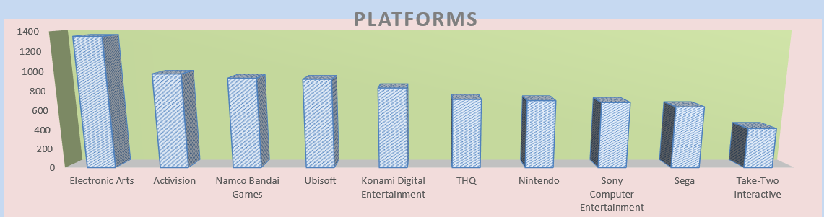
Charts & Business Insights (Cont.)
Target those publishers to launch a new game into the market
Helps a company that wants to start a business in the Video game
Electronics Arts

Slide 8
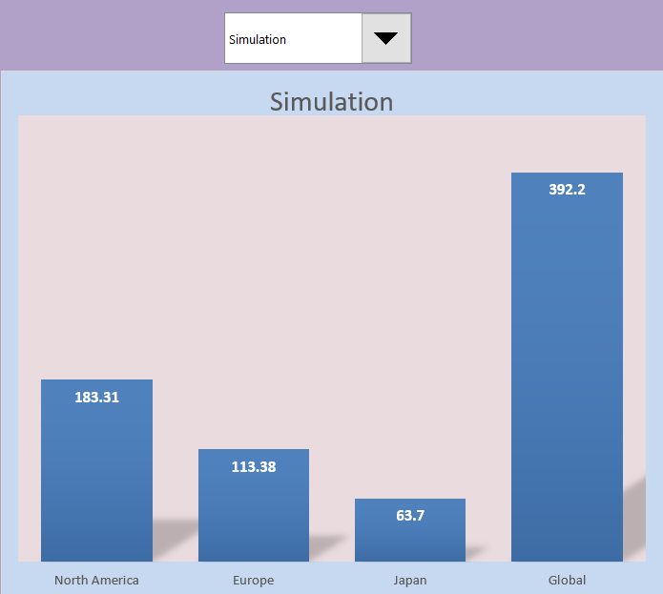
Charts & Business Insights (Cont.)
Finding the best Genre in various countries
For simulation, target North America
Which Genre is more famous in Japan?

Slide 9
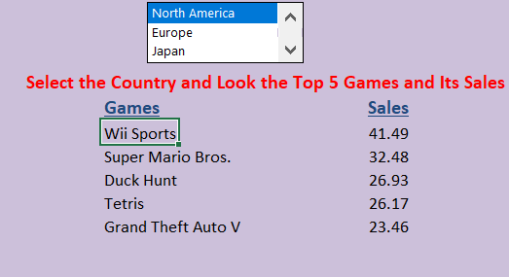
Charts & Business Insights (Cont.)
Target those games based on the country for more sales
Look at these games' popularity based on the country, and can sales accordingly

Slide 10
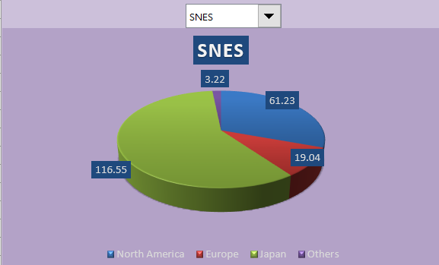
Charts, Process & Business Insights (Cont.)
Target these countries to create a new game on those platforms
Look at Japan for SNES
Which platform is the best for Europe

Slide 11
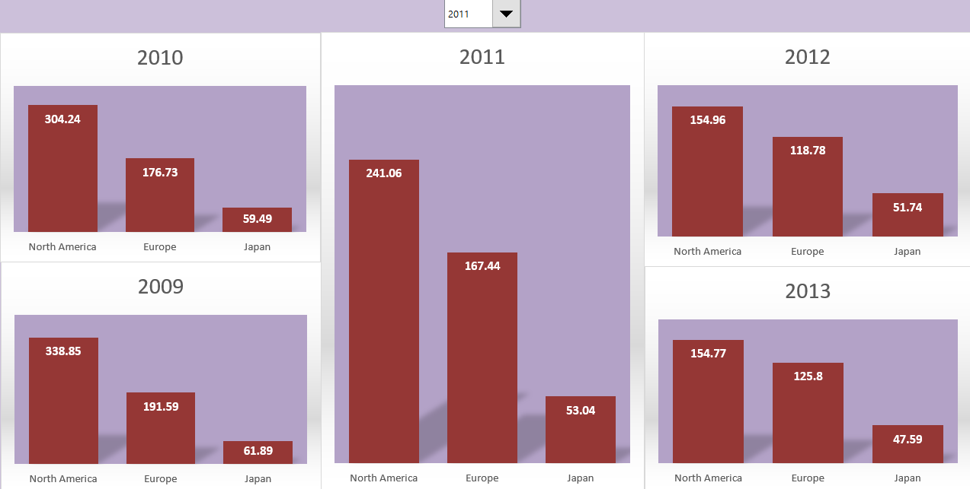
Charts & Business Insights (Cont.)
How sales are changed (increased/decreased) based on the year
Are these sales are increasing or decreasing based on year increases

Slide 12

Thank You!!

